Slide 1
Turfgrass Equipment
Aeration Equipment
Air Injection
Deep Drill
Fraise Mower
Hollow tines
Hollow tine aerator
Solid tines
Solid tine aerator
Spiker/Slicer
Vertical Mower/Verticutter
Water Injection
Air Filter
Blower
Broom
Diaphragm Pump
Drag Mat
Edger
Fertilizer Spreader
Drop
Rotary
Tractor Mounted
Front End Loader
Fuel Filter
Fuel Tank
Grader/Laser Level
Groomer
Hydraulic Filter
Hydraulic Line
Hydraulic Pump
Hydraulic Reservoir
Mowers
Flail
Reel
Rotary
Oil Filter
Painter
Reel Mower HOC Gauge/Accu-Gage
Reel Mower Components
Spider
Reel cylinder
Reel blade
Shaft
Bedbar
Bedknife
Bedknife adjuster
Roller
Roller adjuster
Rotary Mower Components
Mulching blades
Bench grinder
Balancer
Roller
Seeder
Skid-Steer
Sod cutter
Soil Probe
Sprayers
Backpack
Boom
Sweeper
Tamp
Topdresser
Tractor
Transit
Trencher
Trimmer - Line trimmer/weed whacker
Utility Vehicle
York Rake

Slide 2
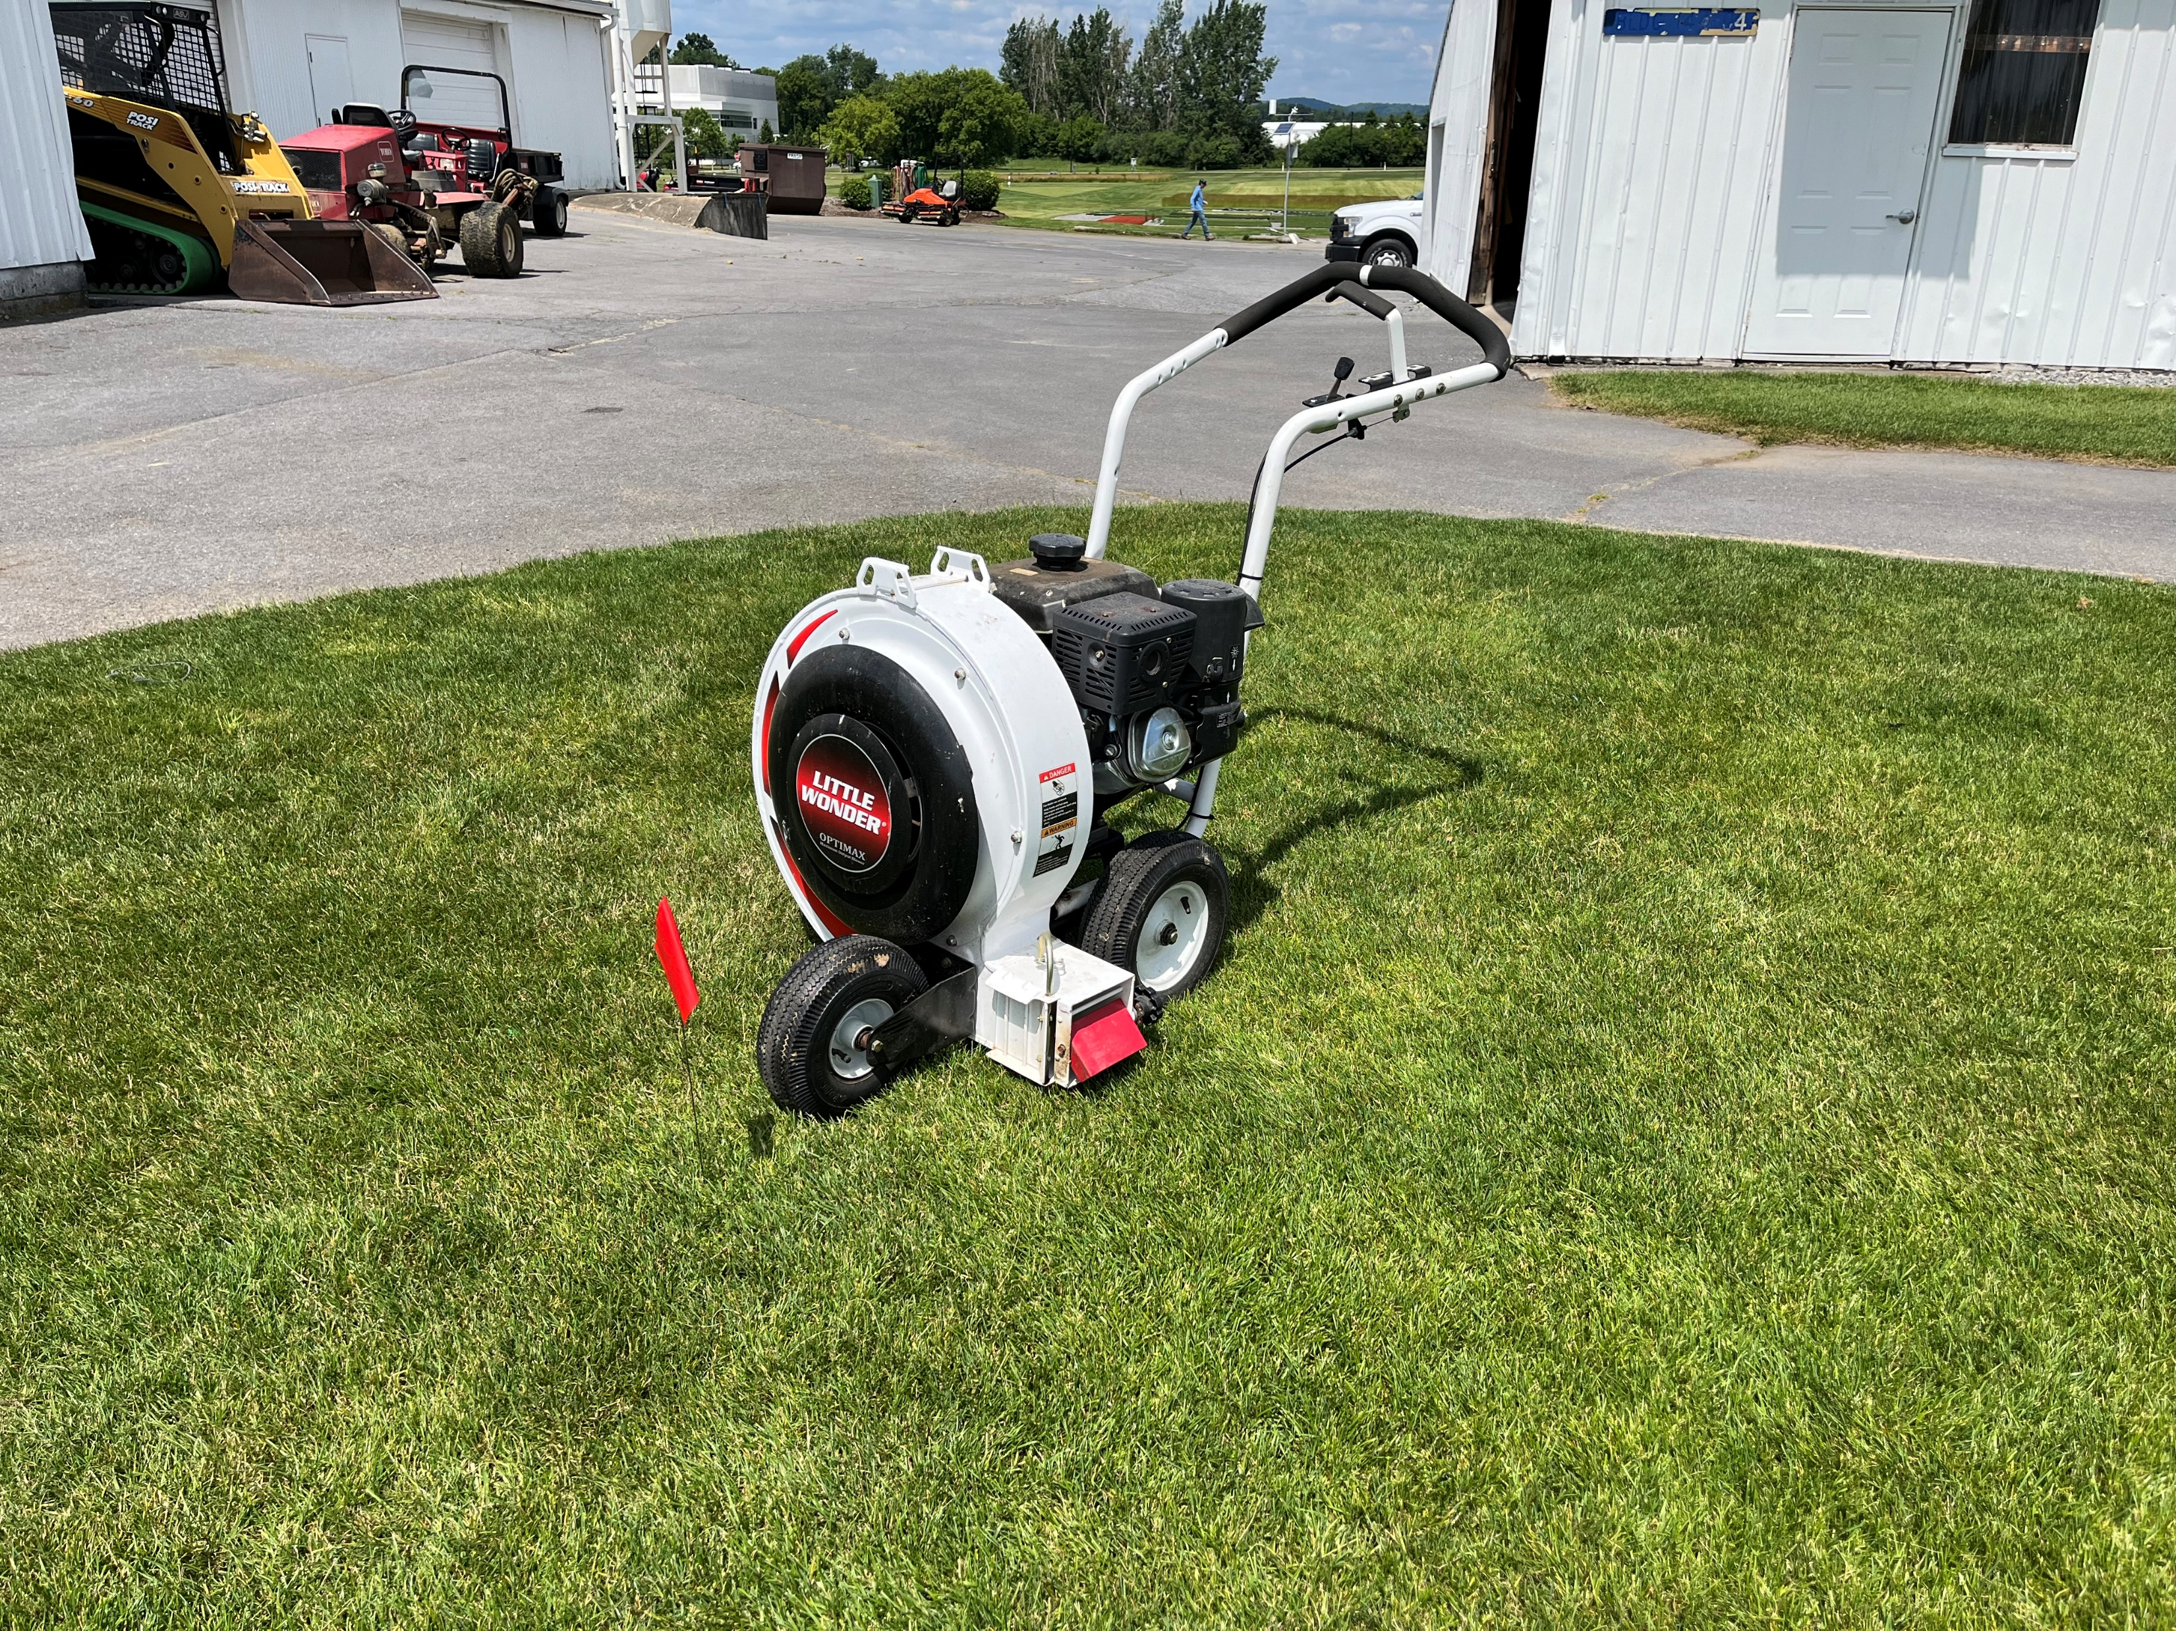
Notes:
Blower

Slide 3
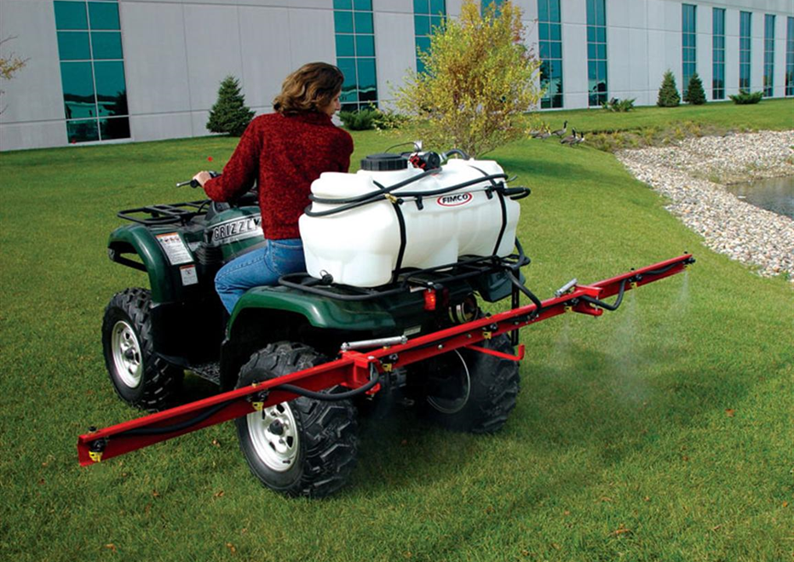
Notes:
Boom Sprayer

Slide 4
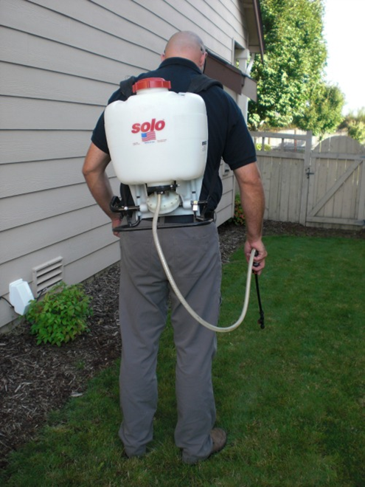
Notes:
Backpack Sprayer

Slide 5
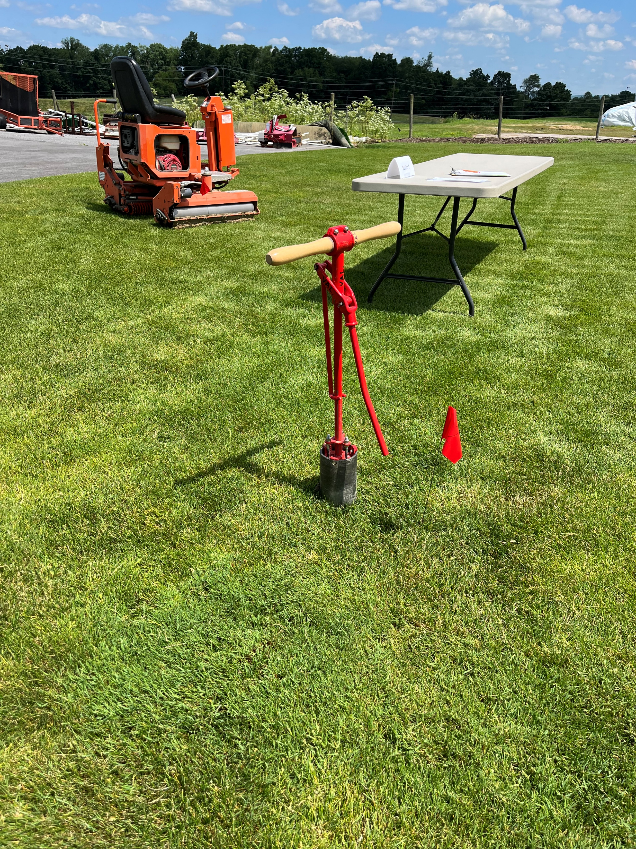
Notes:
Golf course cup cutter

Slide 6
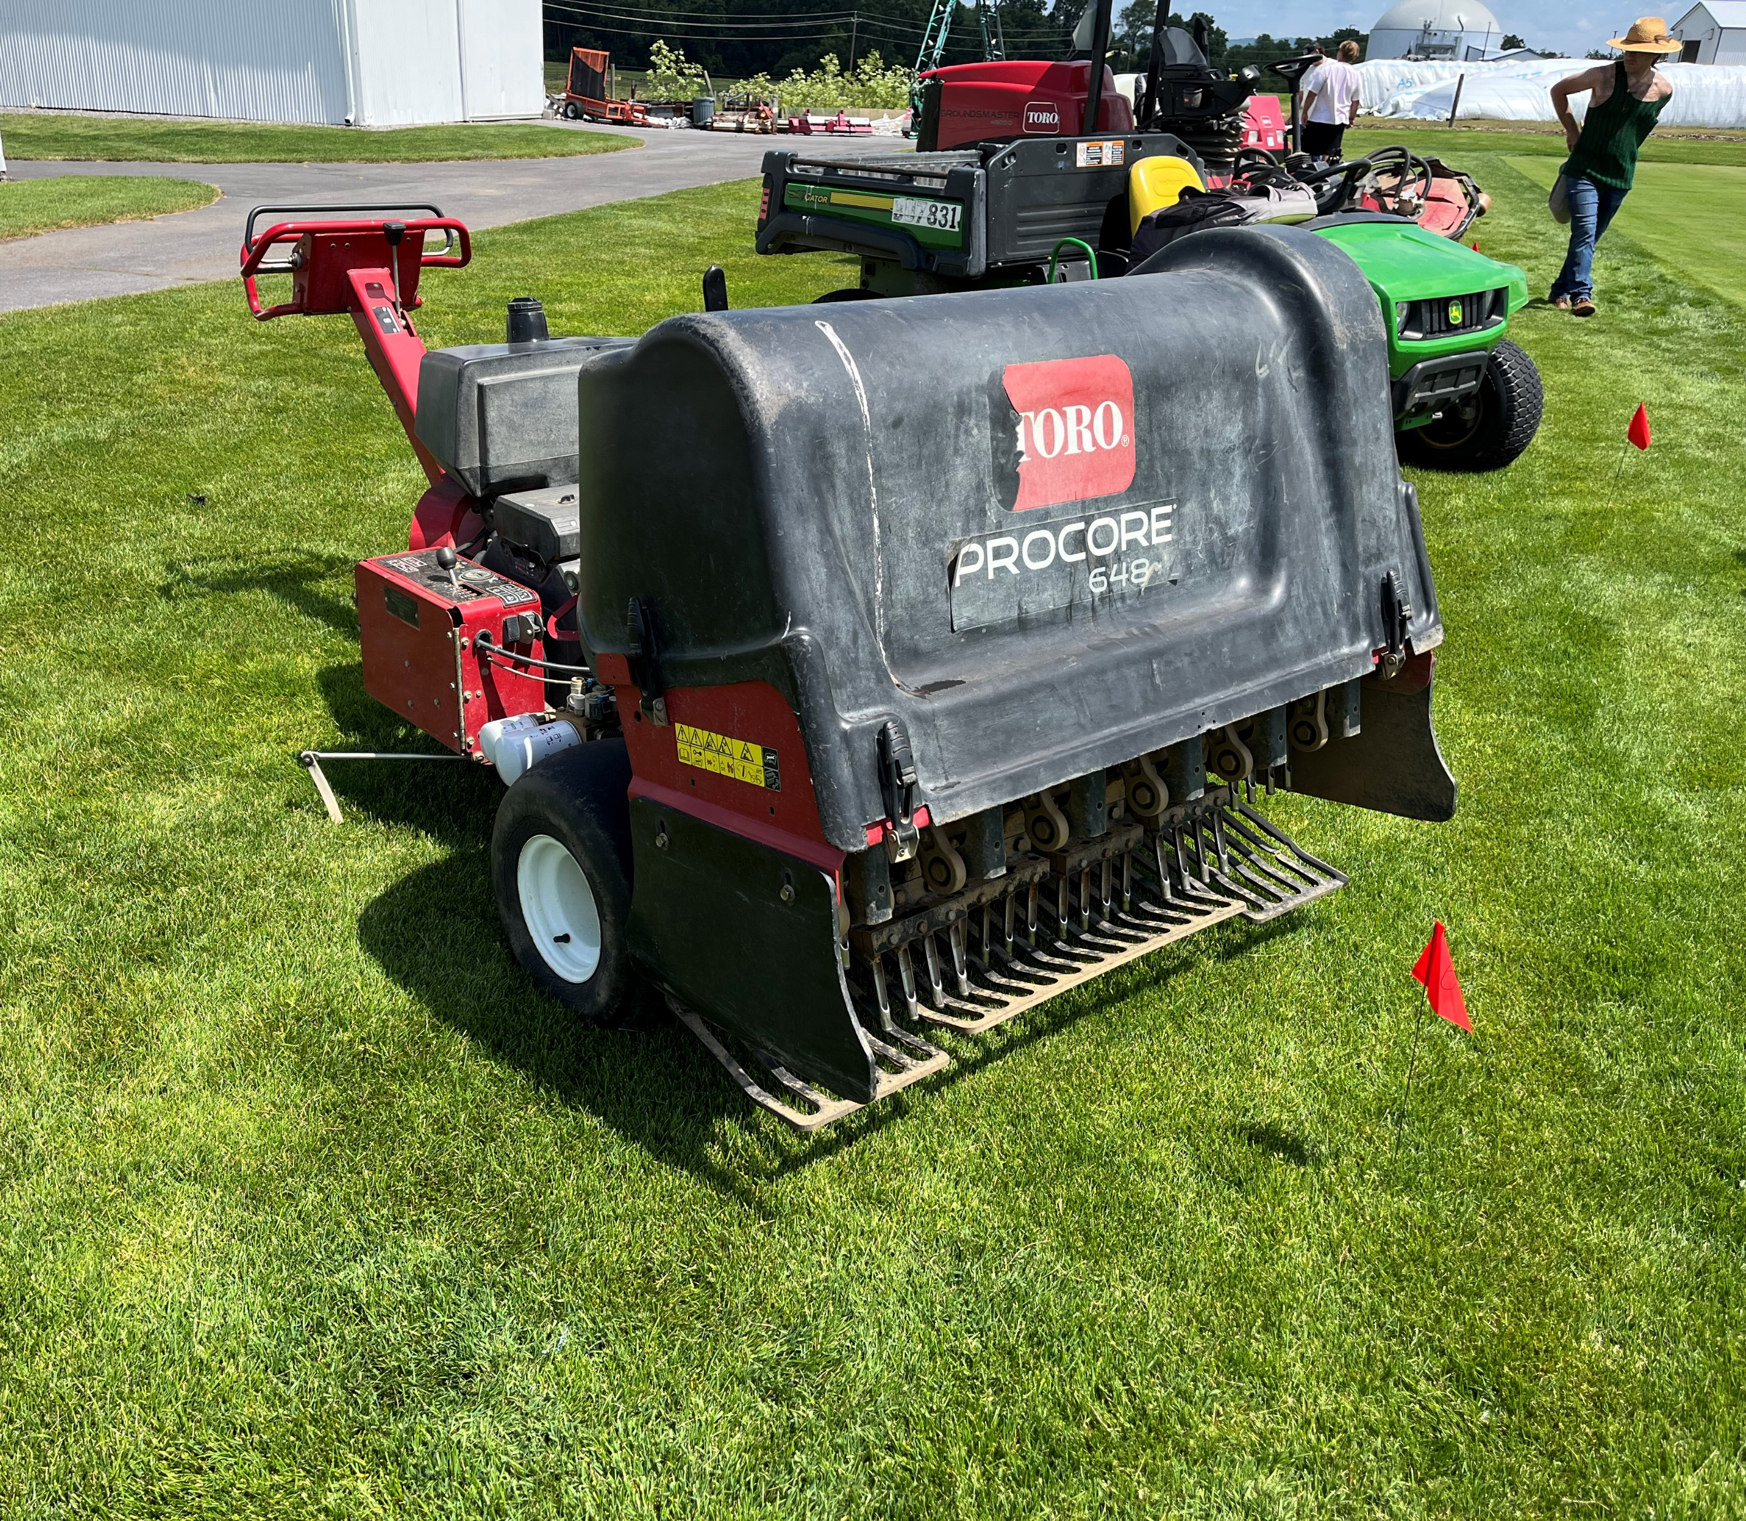
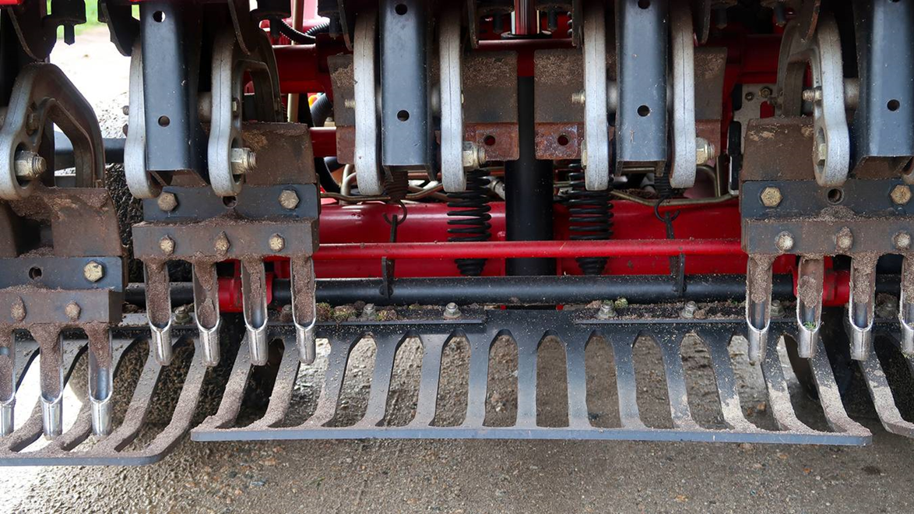
Notes:
Hollow tine aerator

Slide 7
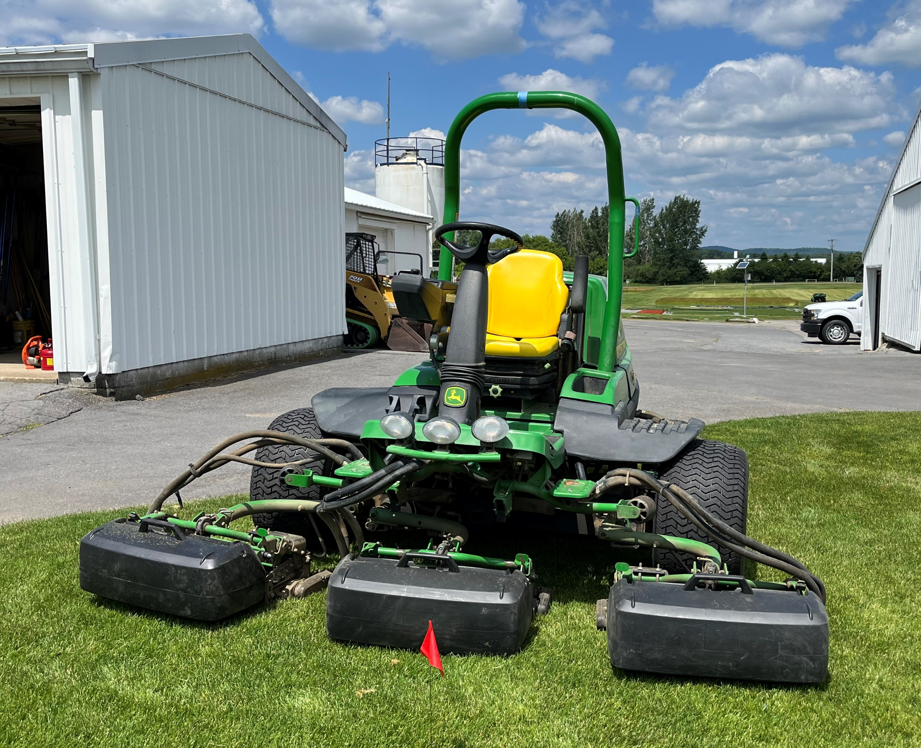
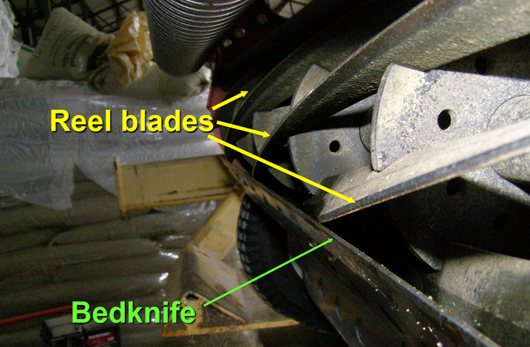
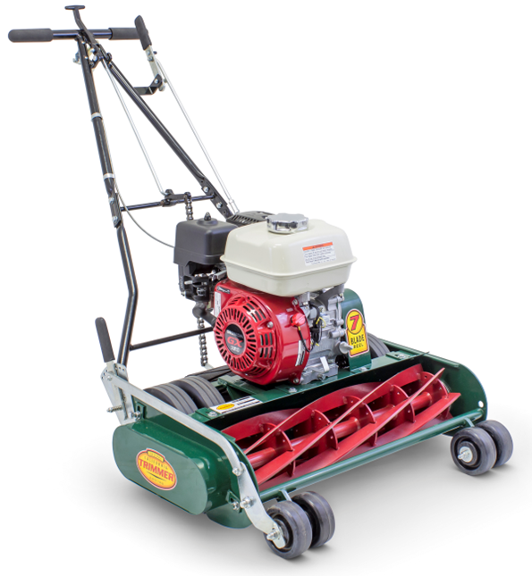
Notes:
Reel mower

Slide 8
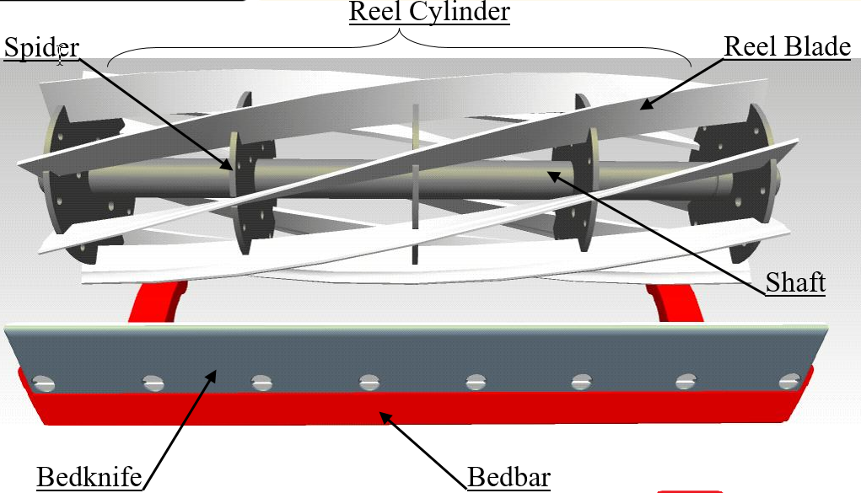
Notes:
Reel parts

Slide 9
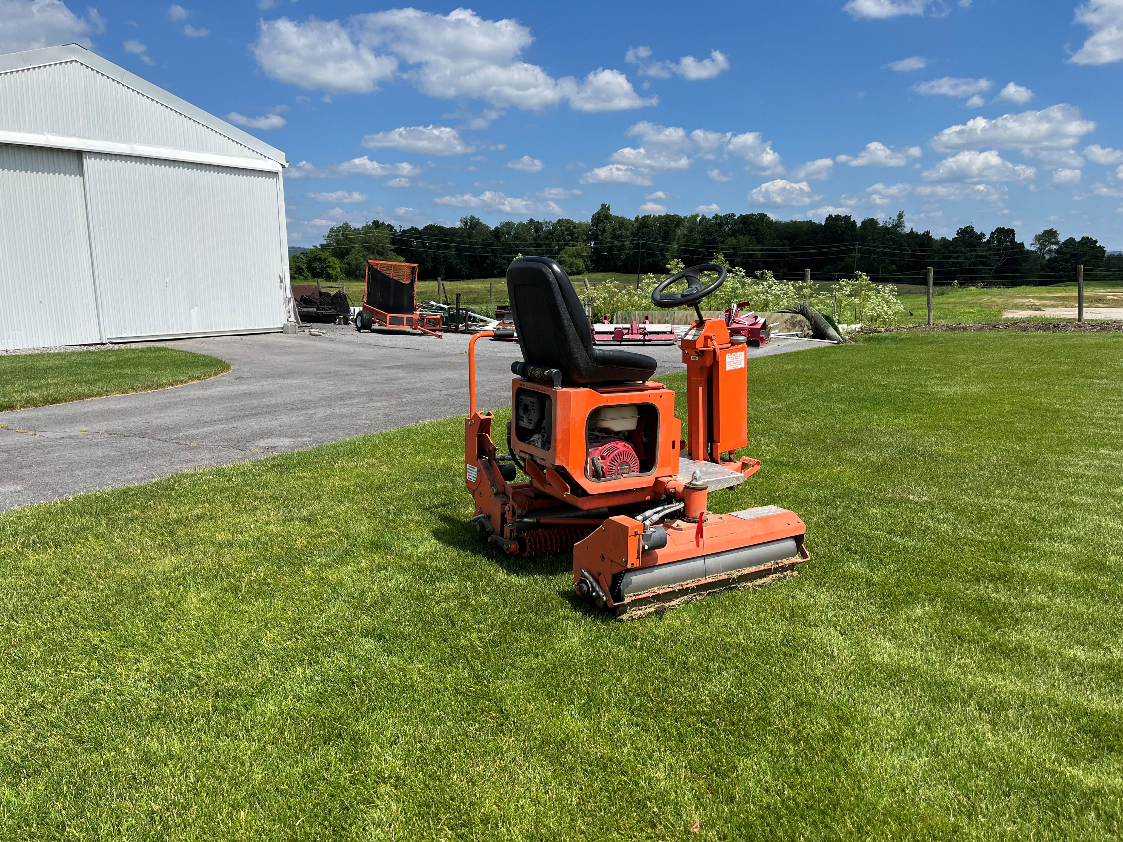
Notes:
Roller

Slide 10
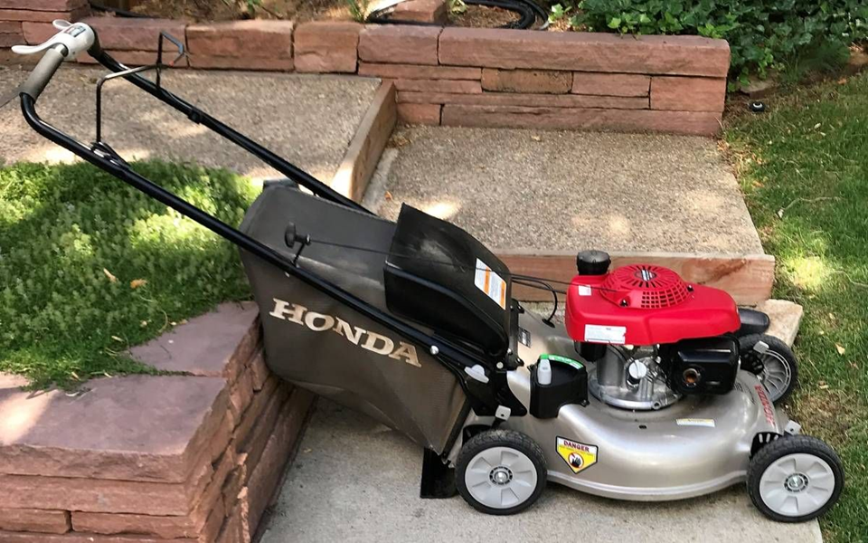
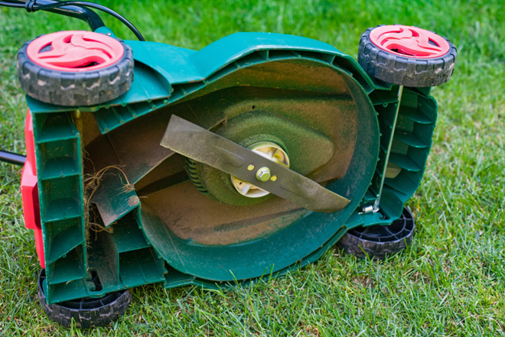
Notes:
Rotary mower

Slide 11
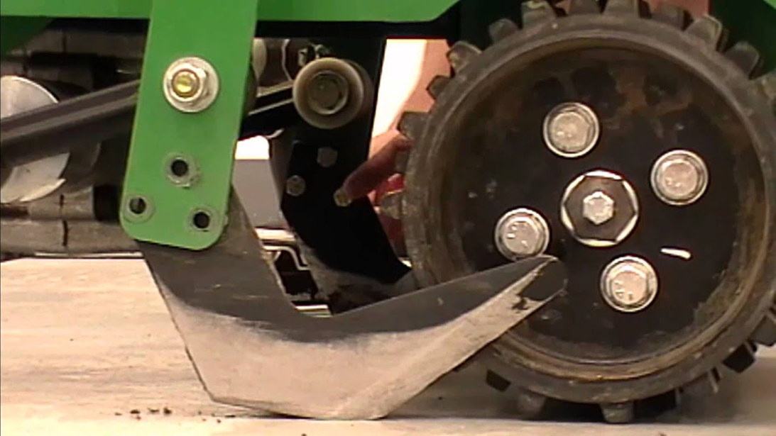
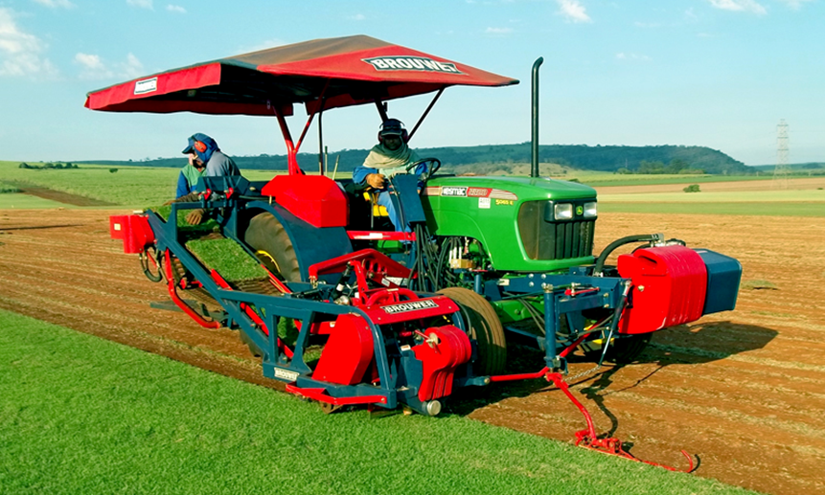
Notes:
Sod cutter

Slide 12
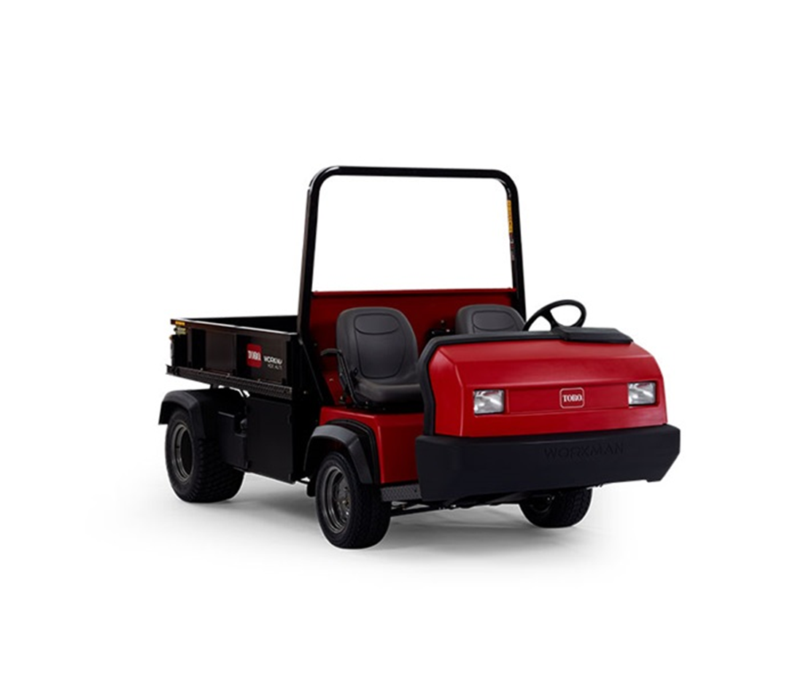
Notes:
Utility vehicle

Slide 13
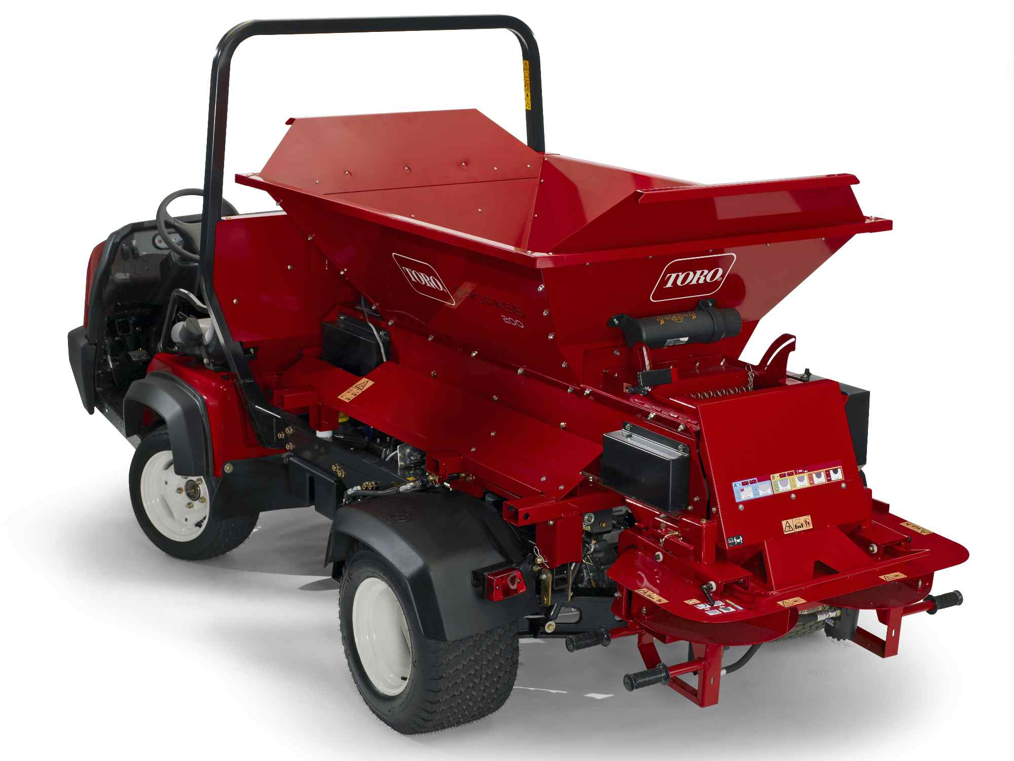
Notes:
Topdresser

Slide 14
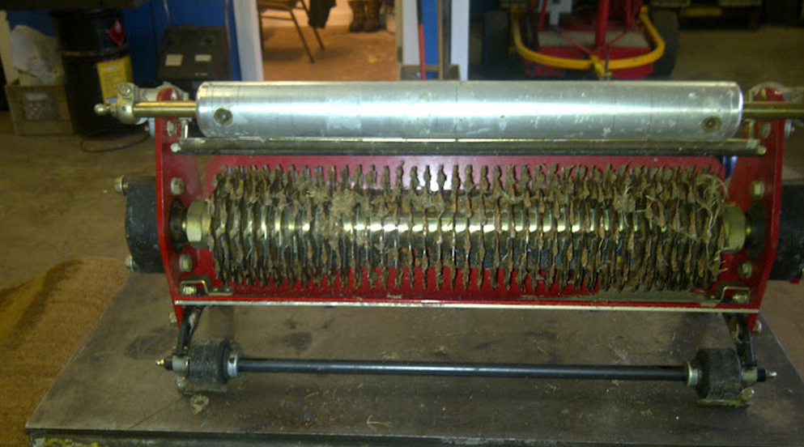
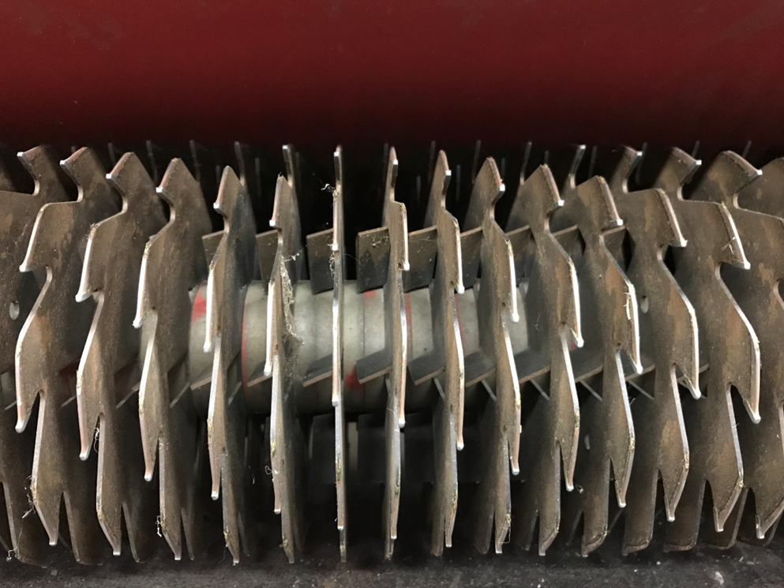
Notes:
Verticutter

Slide 15
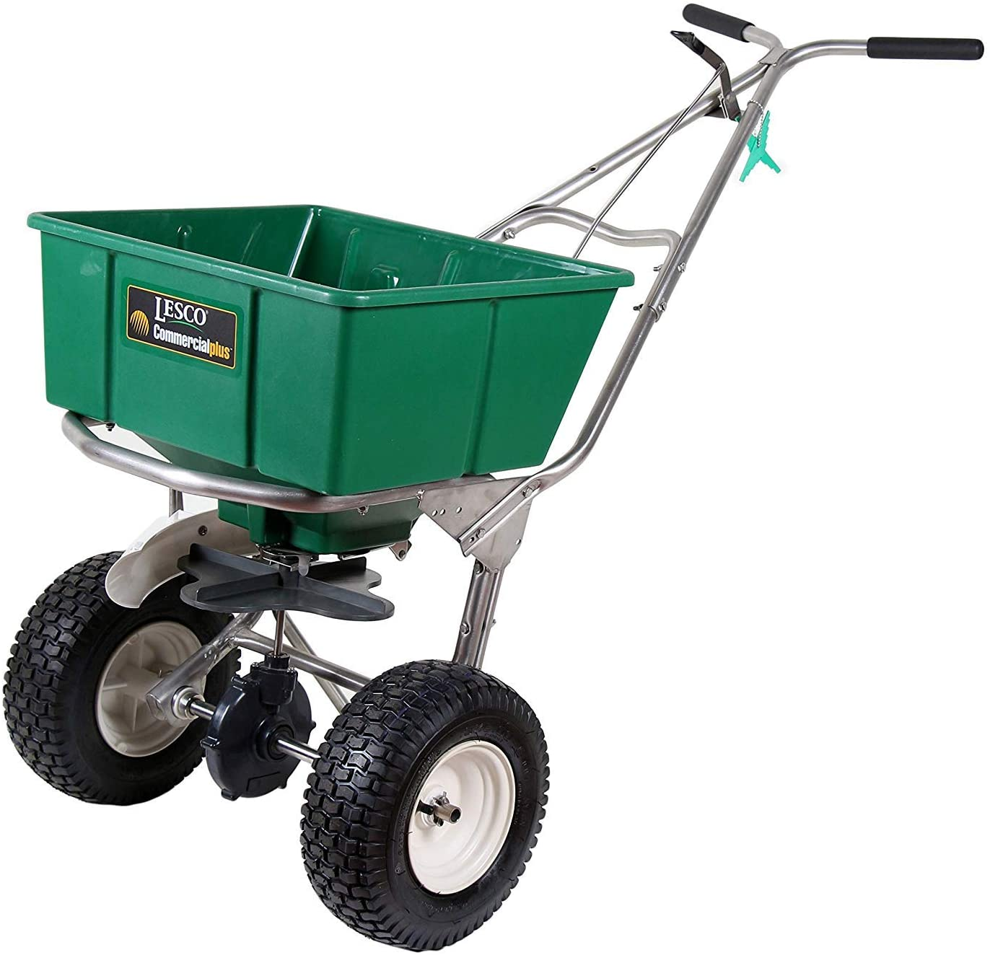
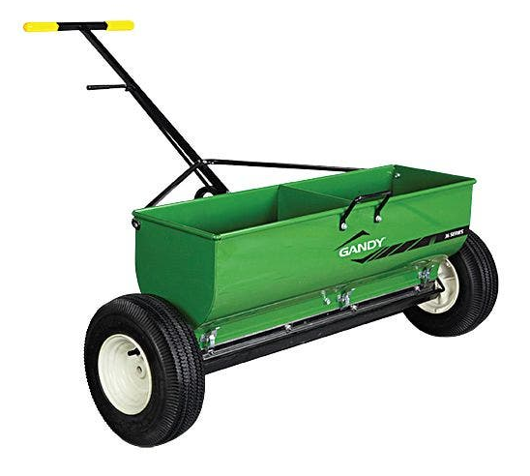
Drop Spreader
Broadcast Spreader
Notes:
Drop spreader (left); rotary spreader (right)

Slide 16
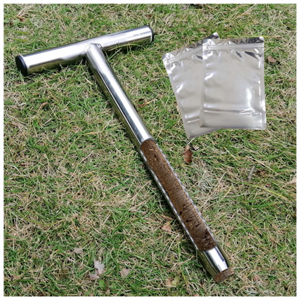
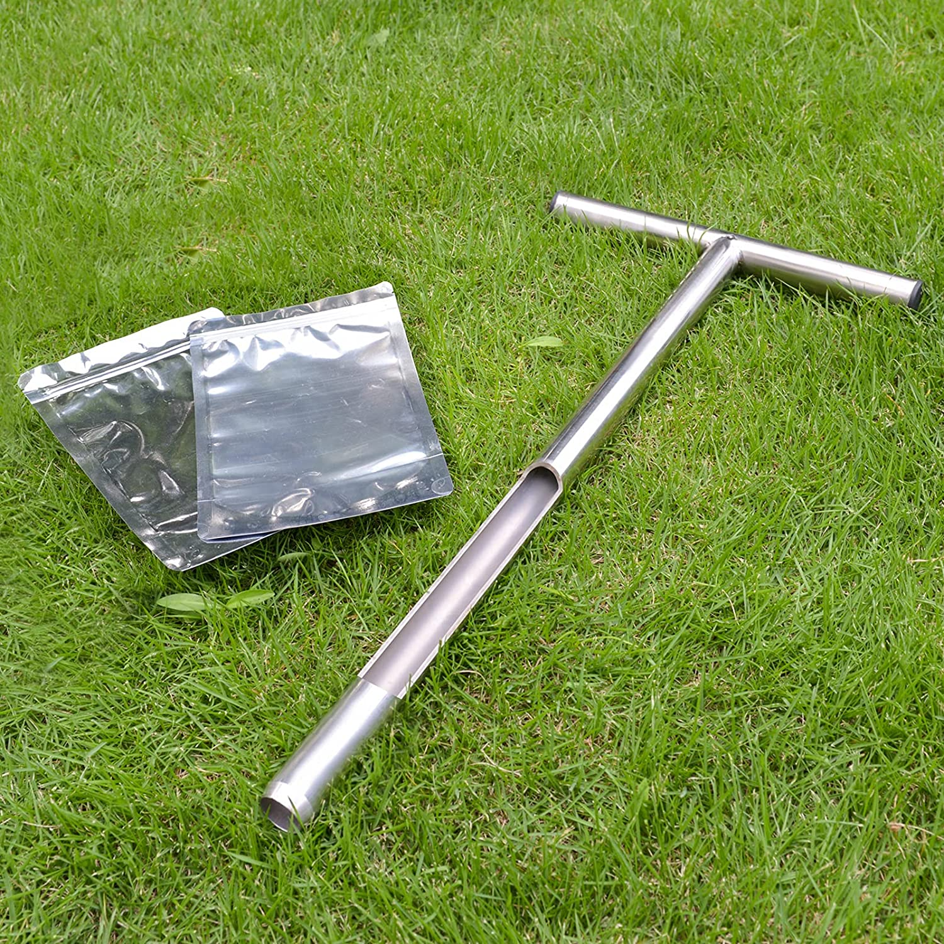
Notes:
Soil Probe

Slide 17
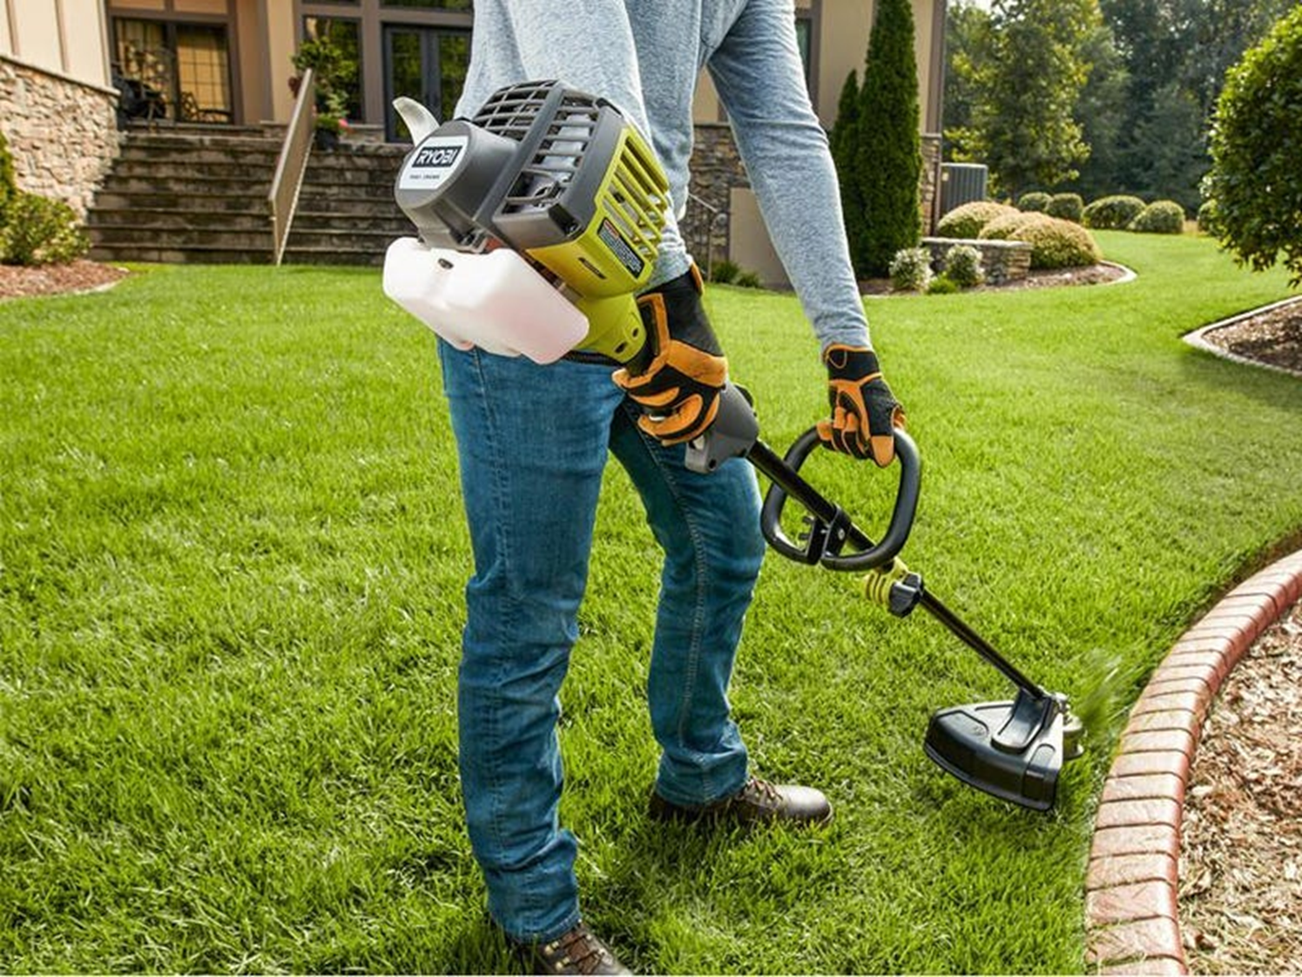
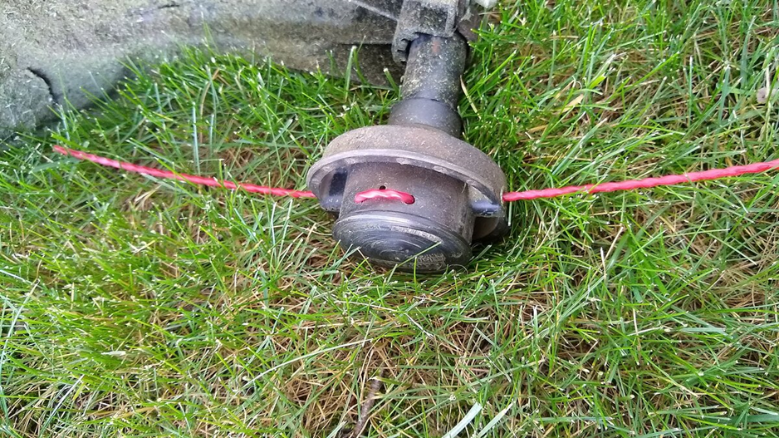
Notes:
String trimmer

Slide 18
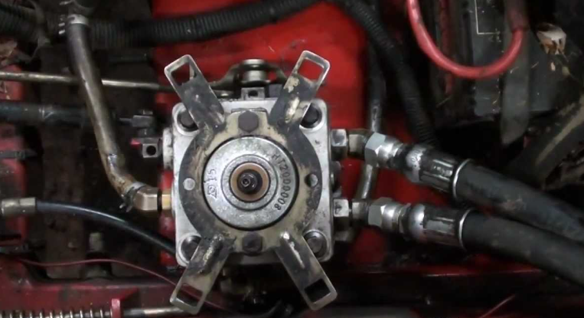
Notes:
Hydraulic pump

Slide 19
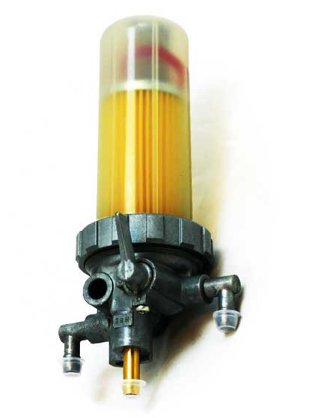
Notes:
Fuel Filter

Slide 20
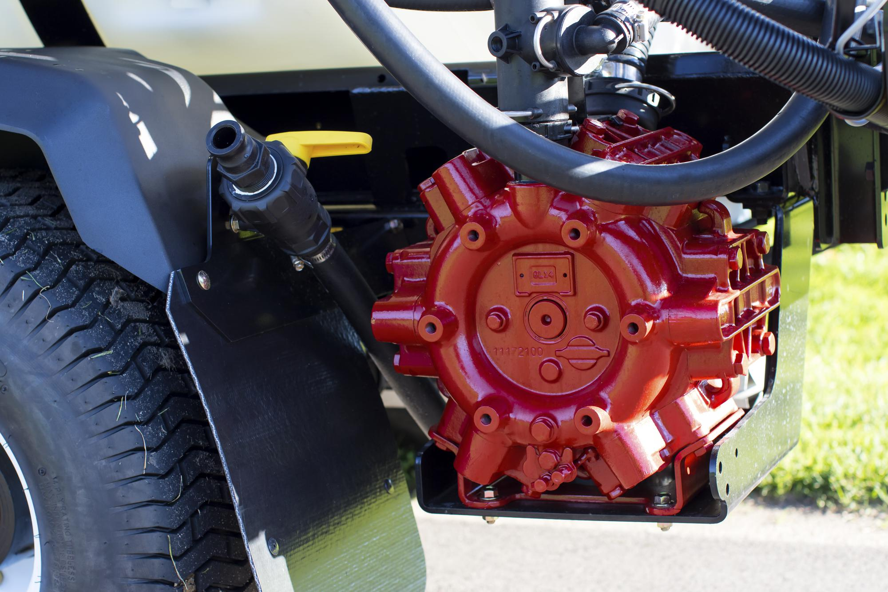
Notes:
Diaphragm pump

Slide 21
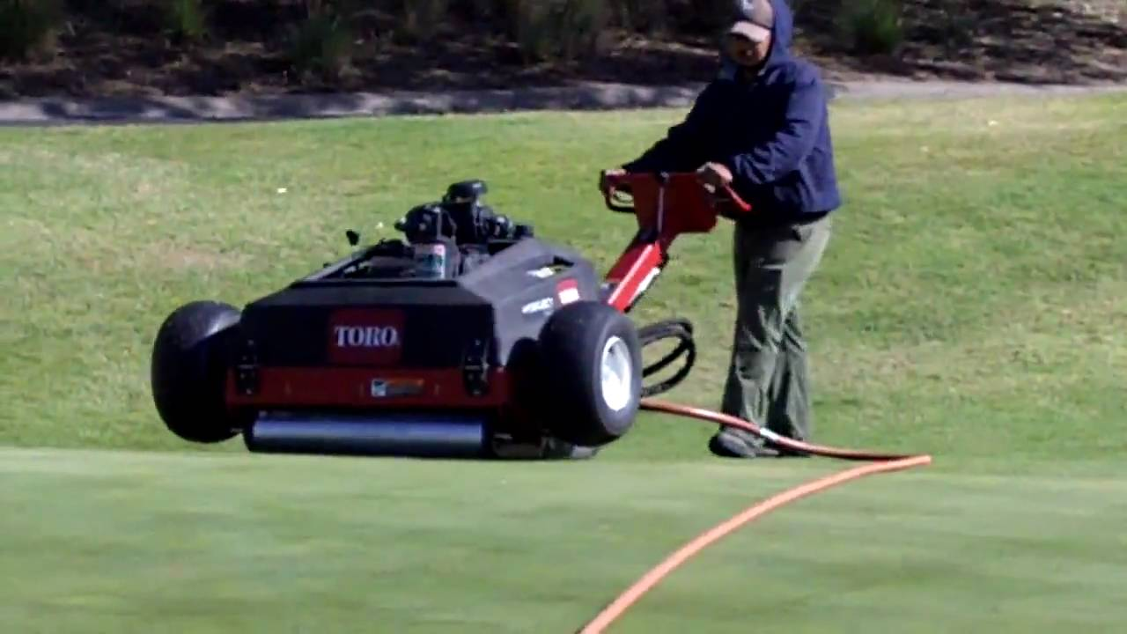
Notes:
Aeration Equipment – Water injection/Hydroject

